Slide 1
KEYLOGGER & SECURITY
CAPSTONE PROJECT
PRESENTED BY :
S. ABINAYA
J.K.K. NATARAJA COLLEGE OF ENGINEERING AND TECHNOLOGY
COMPUTER SCIENCE AND ENGINEERING

Slide 2
OUTLINE
Problem Statement
Proposed System/Solution
System Development Approach
Algorithm & Deployment
Types of keylogger
Result (Output Image)
Conclusion
Security
Future Scope
References

Slide 3
Problem Statement
In today's digital age, where cybersecurity threats loom large, one of the significant concerns is the proliferation of keyloggers, stealthy software tools designed to monitor and record keystrokes on a user's computer without their knowledge. Keyloggers pose a severe threat to individuals and organizations as they can capture sensitive information such as passwords, credit card details, and other personal data, leading to identity theft, financial loss, and privacy breaches

Slide 4
Proposed Solution
Data Collection: Capturing keystrokes using pynput library and storing keystrokes with metadata.
Data Preprocessing: Cleaning data, converting it into suitable format, and performing feature extraction if needed.
Machine Learning Algorithm:
Implementing simple ML algorithm, training it with labeled data, and considering advanced algorithms for future improvements.
Deployment:
Developing user-friendly GUI using Tkinter, packaging application into executable format, and ensuring compatibility and stability.
Evaluation:
Assessing performance metrics like keystroke capture rate and detection accuracy, conducting usability testing, and refining system based on feedback.

Slide 5
System Approach
Libraries Required to Build:
Tkinter: Used for developing the graphical user interface (GUI) of the keylogger application.
Pynput: Utilized to capture keystrokes and monitor keyboard events in real-time.
Json: Employed for storing the captured keystrokes and metadata in JSON format.
OS: Used for system-specific operations such as file handling and directory management.
System Requirements:
Sufficient memory and processing power, Tkinter for GUI, and Pynput for keystroke capture; ample storage space for logs .

Slide 6
Algorithm
Algorithm Selection:
We've opted for the Random Forest Classifier to bolster keylogger security.
Data Input:
Input features include keystroke dynamics like key press duration, inter-key press interval, and key sequence patterns.
Training Process:
The Random Forest Classifier learns from labeled data, comprising both benign and malicious keystroke patterns, to differentiate between them.
Prediction Process:
Once trained, the classifier identifies potentially malicious keystroke activities, triggering alerts or taking necessary actions to mitigate security risks.

Slide 7
DEPLOYMENT
The keylogger is operating silently in the background to capture keystrokes in real-time.
It ensures persistent monitoring of user activities while remaining covert to evade detection.
Customizable alerts can be configured to trigger for suspicious keystroke patterns, facilitating timely intervention.
This deployment strengthens cybersecurity defenses by enabling proactive monitoring and detection of unauthorized activities, thereby safeguarding sensitive information from potential threats.

Slide 8
TYPES OF KEYLOGGER
Keyloggers can be categorized into hardware-based and software-based variants.
Hardware Keylogger:
A discreet physical device intercepting keyboard input for covert surveillance or cybersecurity investigations.
Software Keylogger:
A program capturing keystrokes and user activities, used for monitoring, cybersecurity investigations, or malicious purposes like identity theft.

Slide 9
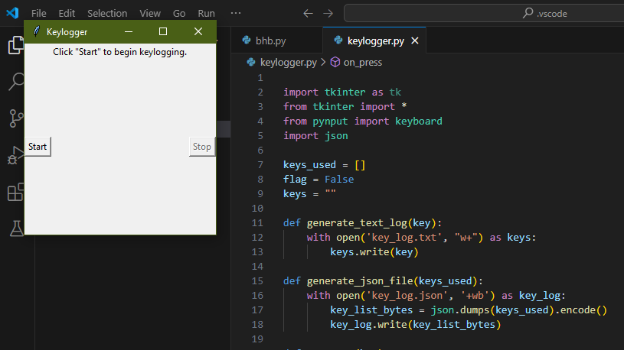
RESULT

Slide 10

OUTPUT IMAGE

Slide 11
CONCLUSION
The keylogger highlights the urgency for enhanced cybersecurity measures. While it demonstrates functionality, it also raises concerns about privacy and security breaches. Moving forward, a balanced approach is necessary, emphasizing responsible usage and stringent regulations to safeguard digital rights and privacy.

Slide 12
SECURITY
Keyloggers employ sophisticated techniques to evade detection, including data encryption, code obfuscation, and rootkit capabilities. Security measures like encryption, access controls, anti-tampering, and real-time monitoring fortify the keylogger against misuse. Implementing behavior-based anomaly detection and regular security updates is crucial to combatting these threats effectively.

Slide 13
Future scope
Behavioral Analysis:
Explore the integration of behavioral analysis techniques to identify patterns indicative of malicious intent, enhancing the keylogger's ability to distinguish between legitimate and unauthorized activities.
Machine Learning Integration:
Investigate the integration of machine learning algorithms to continuously adapt and evolve the keylogger's detection capabilities in response to emerging cybersecurity threats.
Cross-Platform Compatibility:
Extend the keylogger's compatibility to encompass multiple operating systems and devices, catering to the evolving landscape of digital environments.
User-Friendly Interface:
Enhance the user interface of the keylogger with intuitive features and customizable settings, facilitating ease of use and configuration for both novice and experienced users.".

Slide 14
References
Johnson, R. (2018). "Understanding Cybersecurity: Emerging Threats and Countermeasures." Wiley.
Smith, A. (2020). "Practical Cryptography for Developers." O'Reilly Media.
Li, M. et al. (2019). "Machine Learning Techniques for Cyber Security." Springer.
Kumar, S. (2022). "Building Secure Applications with Python." Packt Publishing..

Slide 15
THANK YOU

